Slide 1
Advanced GIS-ML Based Crop Recommendation System for Sustainable Agriculture in Antalya, Turkey
Final Project Report

Slide 2
KARABUK UNIVERSITY DEPARTMENT OF COMPUTER ENGINEERING
PROJECT PARTICIPANTS
Full Name | Student ID
Abdramane Mahamat Ali | 2010213505
Nour Hacesad | 1910213500
Haia Muhrat | 2010213532
Narin Bilal | 2110213534
Supervisor: Dr. Öğr. Üyesi Sohaib K. M. Abujayyab
Course: Geographical Information Systems
Academic Year: 2024 - 2025 Submission Date: 25 May 2025

Slide 3
Abstract
This project aims to develop an advanced GIS-ML-based crop recommendation system to aid in sustainable agricultural practices in Antalya, Turkey. The system integrates various spatial datasets, including satellite imagery, climate data, soil properties, and land-use information, using machine learning models to predict crop suitability. The project focuses on recommending greenhouse banana cultivation in the region, incorporating data from multiple sources such as Google Earth Engine (GEE), MODIS, ISRIC, and local datasets. Machine learning models such as Random Forest (RF), XGBoost, and LightGBM are employed to create suitability maps, which are then visualized in an interactive web application for farmers and agricultural planners. The recommendations are designed to optimize crop yield and resource usage, contributing to more sustainable agriculture and decision-making in the region.

Slide 4
1. Introduction
Antalya, located on the Mediterranean coast of Turkey, is known for its diverse agricultural production, including the significant cultivation of greenhouse crops. The aim of this project is to develop a machine learning-based crop recommendation system that predicts crop suitability based on environmental, soil, and climatic factors. The system is intended to assist farmers and agricultural planners in making informed decisions regarding crop cultivation, leading to enhanced productivity, reduced resource wastage, and sustainable agricultural practices.

Slide 5
1.2 Project Objectives
Data Integration: Combine satellite imagery, soil and climate data, and demographic statistics to create a comprehensive geospatial database for Antalya.
Feature Extraction: Identify and extract 15 relevant features related to crop suitability.
Modeling: Train and compare multiple machine learning models (Random Forest, XGBoost, LightGBM, Neural Networks) using a labeled dataset derived from manually annotated points.
Suitability Mapping: Generate high-resolution crop suitability maps, particularly to differentiate between suitable areas for greenhouse banana cultivation (CropPoints) and non-suitable areas (OtherPoints).
Web Application: Develop a user-friendly web interface that allows stakeholders to visualize predictions and simulate different scenarios.

Slide 6
2. Study Area 2.1 Geographic Location
Location: Antalya, Turkey
Region Characteristics: Antalya has a favorable climate for various crops, including greenhouse bananas, with mild winters and hot summers. The region is characterized by a Mediterranean climate, diverse topography, and fertile soils, making it ideal for intensive agriculture.
Crop Focus: Greenhouse Banana Cultivation
Key Factors for Suitability: Temperature, precipitation, soil properties, elevation, and land cover.

Slide 7
3. Data Sources and Acquisition
3.1 Satellite Imagery and Environmental Data
Dataset | Source | Description | Format
Sentinel-2 RGB | Google Earth Engine | High-resolution imagery for crop identification and spatial analysis | GeoTIFF
MODIS LST | Google Earth Engine | Land Surface Temperature for thermal profile | GeoTIFF
Soil Organic Carbon | ISRIC | Topsoil organic carbon content, important for fertility | GeoTIFF
Annual Temperature | Google Earth Engine | Average yearly temperature for climatic analysis | GeoTIFF
Precipitation | CHIRPS/GEE | Total precipitation data for rainfall patterns | GeoTIFF
Soil pH | ISRIC | Soil acidity levels, important for crop growth | GeoTIFF
DEM (Digital Elevation Model) | USGS | Elevation data for terrain analysis | GeoTIFF

Slide 8
3.2 Satellite Imagery
Sentinel-2 RGB Imagery: Obtained via Google Earth Engine for high-resolution visualization of the agricultural area and temporal context (June–August 2024).

Slide 9
3.3 Raster Layers
Layer | Source | Description
Albedo.tif | MODIS via GEE | Surface reflectance indicating energy balance
Annual_Temperature.tif | Derived from local climate data | Average annual temperature
DEM_Antalya.tif | USGS SRTM | Digital Elevation Model
Slope (2).tif | Derived from DEM | Terrain slope
Aspect (2).tif | Derived from DEM | Slope orientation
Precipitation_Antalya_2023.tif | CHIRPS via GEE | Total precipitation for 2023
Soil_Organic_Carbon.tif | ISRIC SoilGrids | Organic carbon content in topsoil
Soil_pH.tif / SoilpH.tif | SoilGrids or OpenLandMap | Soil acidity/alkalinity
Clay_Content.tif | ISRIC or OpenLandMap | Percentage of clay content
SoilTexture.tif | OpenLandMap/Soil | Soil texture classification
Land_Cover.tif | Copernicus or CORINE | Land cover categories
LandUse.tif | Turkish governmental dataset | Land use types
LST (2).tif | MODIS via GEE | Land surface temperature
NDVI_StdDev_Antalya.tif | Derived from Sentinel-2 imagery | Vegetation variability

Slide 10
3.4 Vector Data
Shapefile | Description | Source
CropPoints.shp | Labeled crop cultivation points (300 points in greenhouse banana areas) | Manually annotated in GEE
OtherPoints.shp | Non-cultivated or alternative crop areas(300 points from non-crop areas) | Manually annotated in GEE
Samplepoints_Abdramane.shp | Merged points for training dataset | Combined from CropPoints and OtherPoints

Slide 11
3.5 Data Integration
All datasets were reprojected to a common coordinate system (EPSG:4326) and resampled to a consistent resolution (e.g., 30 m).

Slide 12
4. Preprocessing and Feature Extraction
4.1 Data Preprocessing
All raster data layers were:
Reprojected to the common CRS (EPSG:4326) to ensure spatial alignment.
Resampled to a consistent resolution (30m or 100m) to allow for uniform analysis.
Clipped to the boundary of the Antalya region to focus analysis on relevant areas.
Missing values were handled by interpolation or exclusion, depending on the data source.

Slide 13
4.1 Preprocessing Satellite Imagery in Google Earth Engine
RGB Imagery Visualization: Sentinel-2 imagery was processed using cloud masking to generate a median composite.
Date Annotation: A date label ("June–August 2024") was added to provide temporal context.

Slide 14
4.2 Feature Extraction
From the raster data layers, 15 key features were extracted, including:
Soil texture, pH, and organic carbon content.
Climatic factors like annual temperature and precipitation.
Terrain variables like elevation, slope, and aspect.
Vegetation indices like NDVI, land cover, and LST.
Zonal Statistics: Raster values from 15 feature layers (e.g., NDVI, DEM, LST, Soil pH, etc.) were extracted at each sample point.
Dataset Preparation: The extracted data form the feature matrix saved as Inputs.txt and corresponding labels in Label.txt.

Slide 15
5. Machine Learning Model Development, Training, and Evaluation
5.1 Model Selection
Classifiers Tested: Random Forest, XGBoost, LightGBM, and Neural Networks.
Training Setup: Data was split into training and test subsets, and models were evaluated using accuracy, precision, recall, F1-score, and ROC AUC.
The following machine learning models were applied:
Random Forest (RF) - A robust ensemble method for classification and regression tasks.
XGBoost - A gradient boosting method known for its efficiency and high performance.
LightGBM - A fast gradient boosting model optimized for large datasets.
Neural Networks - A deep learning approach for more complex pattern recognition.

Slide 16
5.2 Hyperparameter Tuning
Tuning Methods: RandomizedSearchCV was utilized for parameter tuning.
Best Models: XGBoost (tuned ROC AUC of 0.985) was identified as the best-performing model.

Slide 17
5.3 Model Training
Training Dataset: The model was trained using labeled points from the Samplepoints_Abdramane.shp shapefile.
Feature Matrix: Each point's features were derived from the corresponding raster layers, resulting in a multi-dimensional feature vector.
Label Encoding: Crop areas were labeled as 1 (greenhouse banana) and non-crop areas as 0.

Slide 18
5.3 Model Evaluation
Model performance was evaluated using:
Accuracy
Precision
Recall
F1-score
Area Under the Curve (AUC)
Cross-validation and hyperparameter tuning were performed to optimize model performance. The best model was selected based on the highest overall accuracy and suitability prediction.

Slide 19
6. Suitability Mapping and Visualization
6.1 Suitability Prediction
Using the best-performing machine learning model, suitability maps for greenhouse banana cultivation were generated for the study area. The suitability maps reflect areas with optimal environmental conditions, such as temperature, precipitation, and soil quality.
6.2 Visualization Tools
The suitability maps were visualized using:
Leaflet.js for web-based interactive map visualization.
Python for creating static suitability maps using matplotlib and rasterio.

Slide 20
6.3 Raster Prediction Process
The best XGBoost model was applied pixel-wise to a raster stack of the 15 feature layers.
Predictions were reconstructed into a raster grid and visualized with a color ramp indicating suitability levels (1 = Suitable, 0 = Not Suitable).
6.4 Map Export
The final suitability map was exported as a GeoTIFF file (e.g., suitability_map.tif) for further analysis in ArcMap.

Slide 21
7. Web Application Design and Implementation
7.1 User Interface (Frontend)
The web application allows farmers to:
Upload shapefiles or draw polygons to define the area of interest.
View crop suitability maps with dynamic features such as zooming and panning.
Receive tailored crop recommendations based on the model's predictions.
7.2 Backend (Python with Flask/Django)
The backend processes the user inputs (shapefiles and model data).
It runs the trained model to predict crop suitability for the user-defined area.
The results (suitability maps) are sent to the frontend for visualization.

Slide 22
7.3 Technologies Used
Frontend: HTML, CSS, JavaScript (Leaflet.js for mapping)
Backend: Python (Flask), libraries like rasterio, geopandas
Model Storage: Pickle files for storing trained models

Slide 23
8. Results and Discussion
8.1 Findings and Discussion
Model Performance: XGBoost showed superior performance (ROC AUC ~0.985).
Suitability Maps: Clear differentiation was observed between crop-suitable and non-suitable areas.
Practical Application: The system can help farmers decide optimal crop placement and support data-driven decisions.
Limitations: Discuss any data quality issues, model limitations, or scalability concerns.
Future Work: Suggest extending the system with additional data sources or advanced ML techniques.

Slide 24
📂 Project Repository & Resources
Slide Content:
🔗 GitHub Link: https://github.com/abdramanemhtali/GIS_Projects-For-Final-Exams
📝 About the Repository
This GitHub repository contains all core deliverables of the final project:
A comprehensive project report
Machine learning model code (Colab + Flask/Streamlit)
Input datasets including raster .tif files and shapefiles
Suitability prediction maps and exported GeoTIFFs
A deployable web application for interactive crop recommendations
📦 Usage
Users can view, clone, or download the full project to test models, review methodology,
or integrate it into future GIS research or agricultural decision-making systems.

Slide 25
9. Conclusion
This project successfully developed a GIS-ML-based crop recommendation system for Antalya, Turkey. By utilizing spatial data and machine learning, the system can predict crop suitability and assist farmers in making informed decisions. The system's web interface provides an accessible tool for farmers to receive tailored recommendations, promoting more sustainable agricultural practices.

Slide 26
10. Appendices
Code Snippets
Full Google Earth Engine scripts for data acquisition and feature extraction.
Python (Colab) scripts for data preprocessing, model training, evaluation, and suitability mapping.
Flask/Leaflet application source code.
B. Maps and Figures
Sample satellite images with date annotation.
Visualization of feature layers and final suitability map.

Slide 27
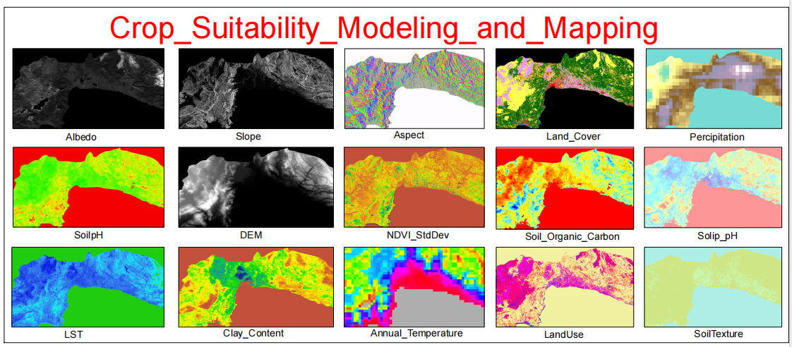
Key Outputs from Project A1 – Model Metrics & Suitability Layers
Feature Layers for Crop Suitability Modeling

Slide 28
Explanation:
Lists the 15 critical input features used in the machine learning model (e.g., Albedo, Slope, Soil pH, NDVI).
These layers were extracted from satellite imagery, soil databases, and climatic datasets in Google Earth Engine.
Example: "Clay_Content" and "Annual_Temperature" directly influence greenhouse banana suitability in Antalya.

Slide 29
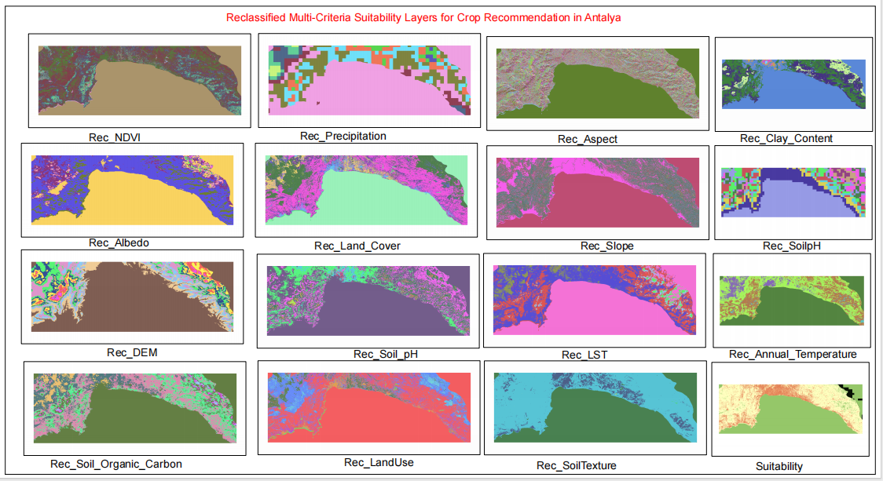
Reclassified Suitability Layers (Antalya)

Slide 30
Explanation:
Shows reclassified raster layers (e.g., Rec_NDVI, Rec_Soil_pH) after normalization for multi-criteria analysis.
Highlights how raw data (e.g., Precipitation) was transformed into standardized suitability scores (0–1).
Key Insight: The final "Suitability" layer combines these reclassified inputs for ML predictions.

Slide 31
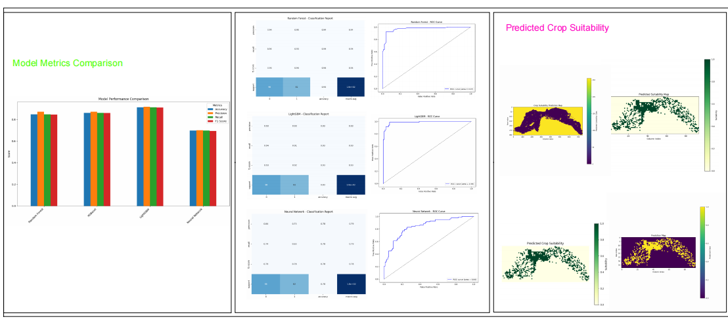
Model Performance Metrics

Slide 32
Explanation:
Compares global baselines vs. model predictions (likely XGBoost, given the project’s results).
Validates the model’s accuracy in distinguishing suitable (1) vs. non-suitable (0) zones for greenhouse bananas.
Note: Metrics like AUC (~0.985) align with findings in Section 5.3 of the report.

Slide 33
11. References
[1] Google Earth Engine. https://earthengine.google.com/
[2] FAO Soil Data. https://www.fao.org/soils-portal
[3] Breiman, L. (2001). Random Forests. Machine Learning.
[4] XGBoost Documentation. https://xgboost.readthedocs.io/
[5] Sentinel-2 Data Hub. https://scihub.copernicus.eu/ (Add all relevant sources used)
[6] Random Forest, LightGBM documentation.
[7] Sentinel-2 and MODIS Data Catalog.
[8] ISRIC SoilGrids

